Slide 1
02 – Customer Care Client

Slide 2
Customer Care Client
Customer Care Client (CCC) is a Windows Forms-based application and is a “thin client” that does not use direct database connection.
CCC uses web services to interact with the Comverse ONE solution real-time charging platform.
CCC also align the SOX security compliant. This mean each users of CCC will have their own set of authorizations & also be audited by the system

Slide 3
Customer Care Client
CCC supports the following subscribers functionalities. Below are example
“Retrieving Subscribers ”
“Changing a Subscriber MSISDN”
“Modifying Subscriber Information Details”
“Working with Subscriber Locations”
“Swapping a Subscriber Primary Offer/Bundle”
“Adding Subscriber Supplementary Offers”
“Viewing a Subscriber’s History ”
“Modifying an RC or NRC Term for a Subscriber”
“Adding a Standalone NRC to a Subscriber”
“Working with Subscriber Calling Circles”
“Working with Subscriber Friends and Family Phonebook”
“Applying Charges for Predefined Administrative Events”
“Deleting a Subscriber”

Slide 4
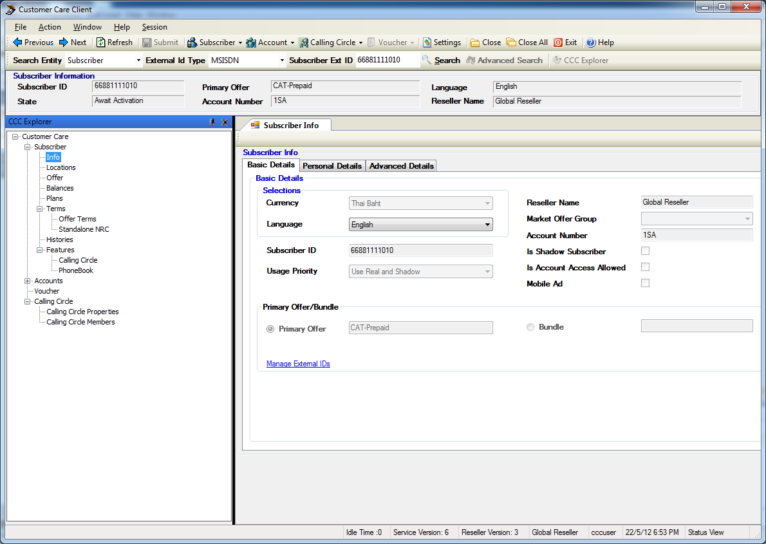
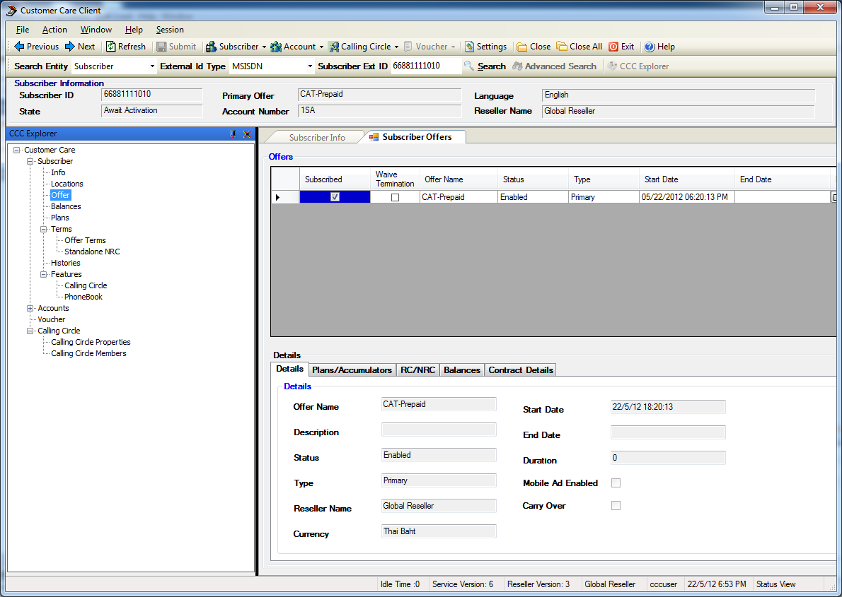
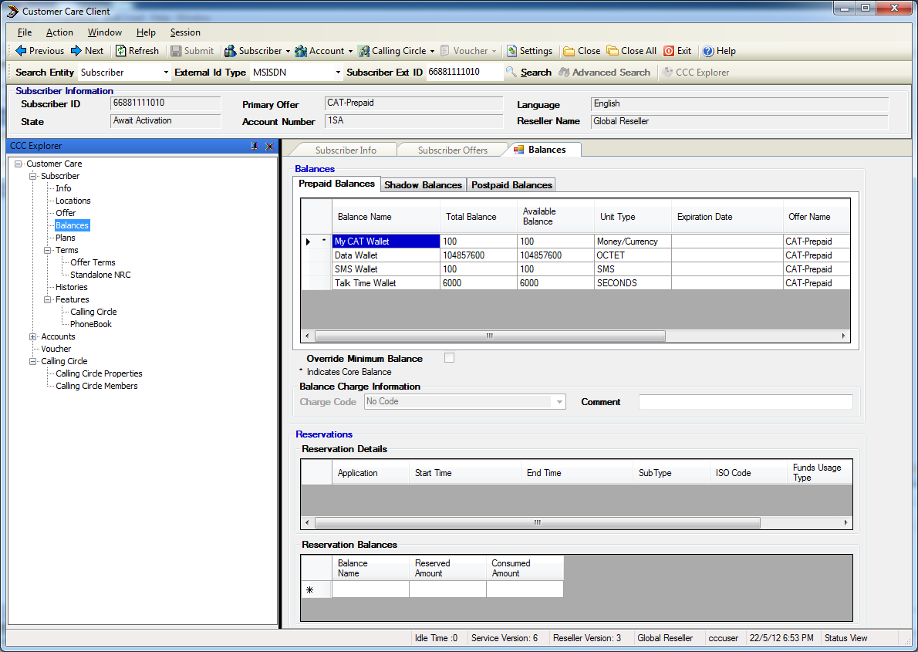
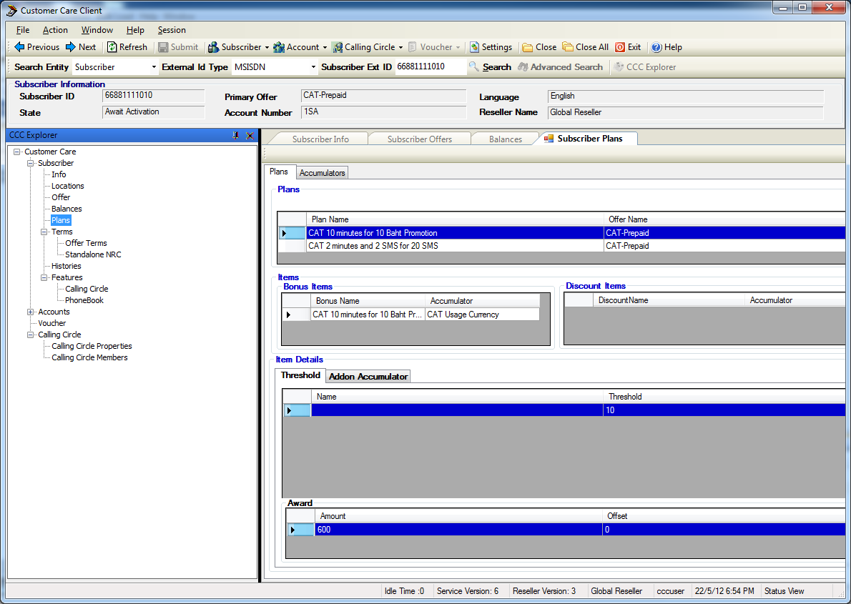
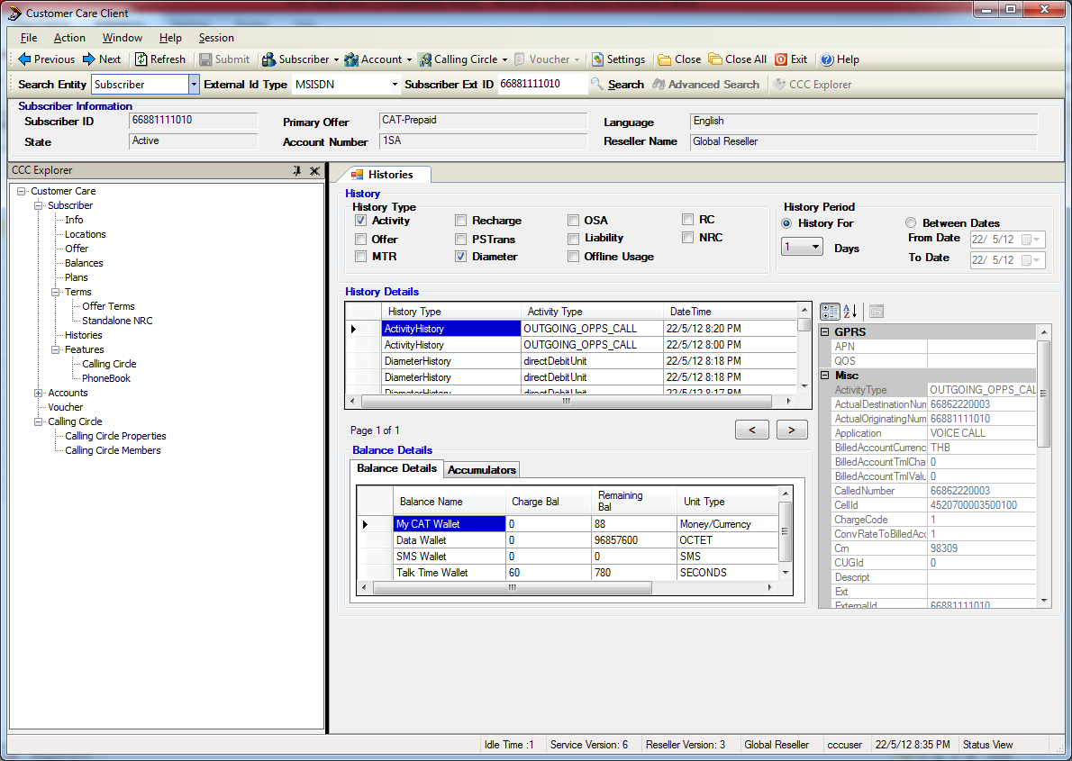
Customer Care Client – Subscriber GUI
4

Slide 5
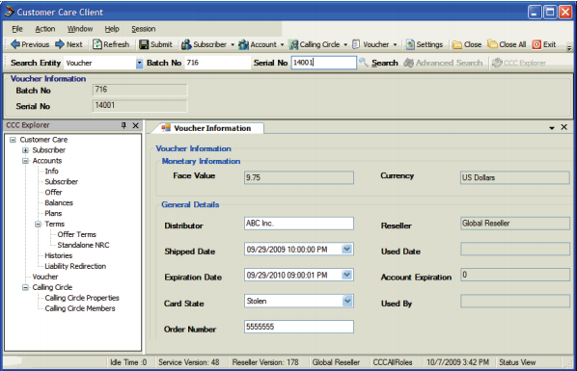
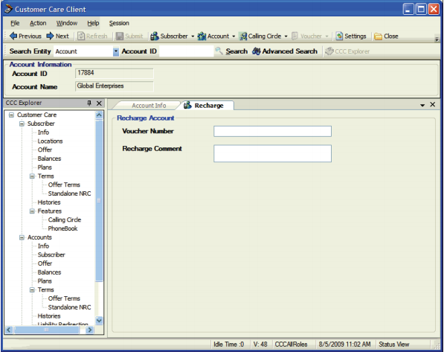
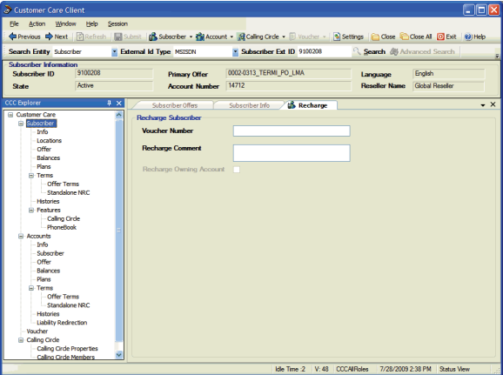
Customer Care Client – Voucher GUI

Slide 6
Recommendation
Recommendation
Please consider the following
Customer Care Client is included SW tool which run on standard windows machine. It integrates to C1-RT via the Unified API (Web Services)
VNP shall use this tool for 2nd line technical support CSR.
Recommend to have different set of CCC users for example
Subscriber Inquiry only capability
Subscriber administrative capability
The CCC provides in depth information for checking all key rating, reservation, charging, promotion, balance movement of the real time usage

Slide 7
Thank you

